Slide 1
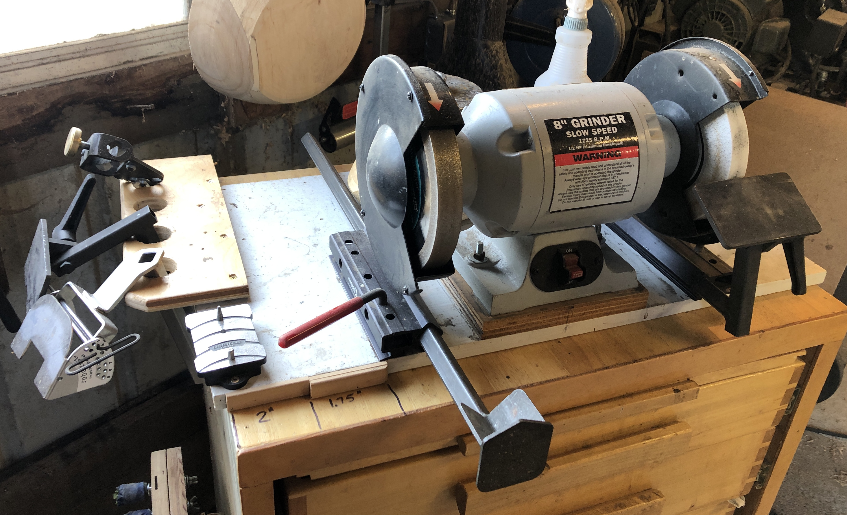
+ Sharpening Lathe Tools
Woodturners need a proper turning tool “sharpening station” close at hand. A common setup shown here features the ONEWAY Wolverine system.
1750 RPM grinder
8” grinding wheels.
Course wheel: 40 to 80 grit
Fine Wheel: 120 to 180+ grit
$300 to $400 (with alum oxide wheels)
Cabinet with space for accessories
SHARPEN EARLY, SHARPEN OFTEN

Slide 2
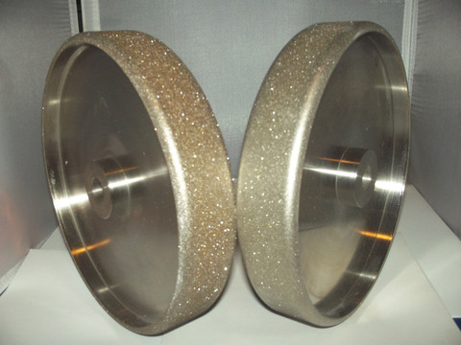
+ Sharpening Lathe Tools
:
Aluminum Oxide – wide selection of characteristics
CBN – Cubic Boron Nitride
“J” hardness rating is ideal
Economically priced ($50)
Wear down with use causing reduced diameter
Must be dressed and trued
Expensive ($150)
10 year+ life
Machined, balanced, and smooth running
No wear - Constant diameter for life of wheel
No dressing required

Slide 3
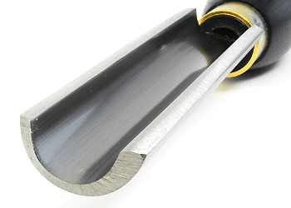
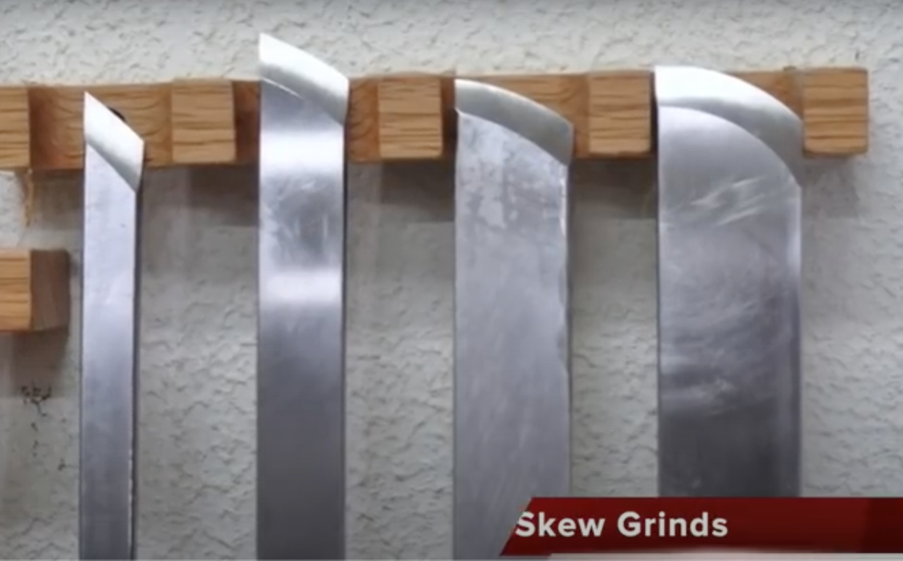
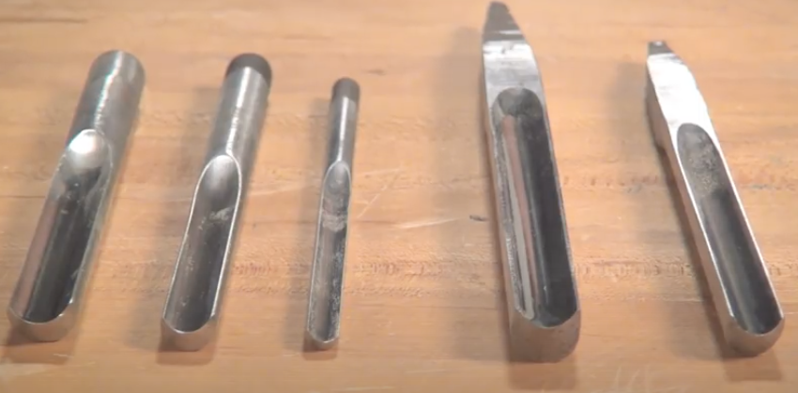
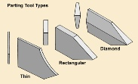
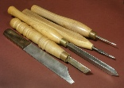
Sharpening Lathe Tools
“Spindle” Tools:
Spindle “Roughing” gouge
Spindle gouges and detail gouges
Skews
Parting Tools

Slide 4
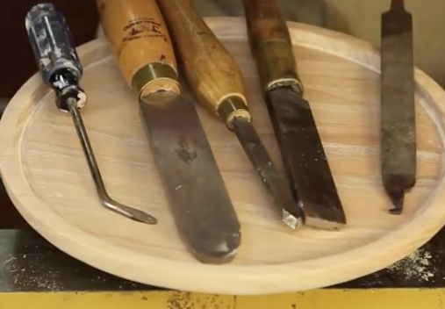
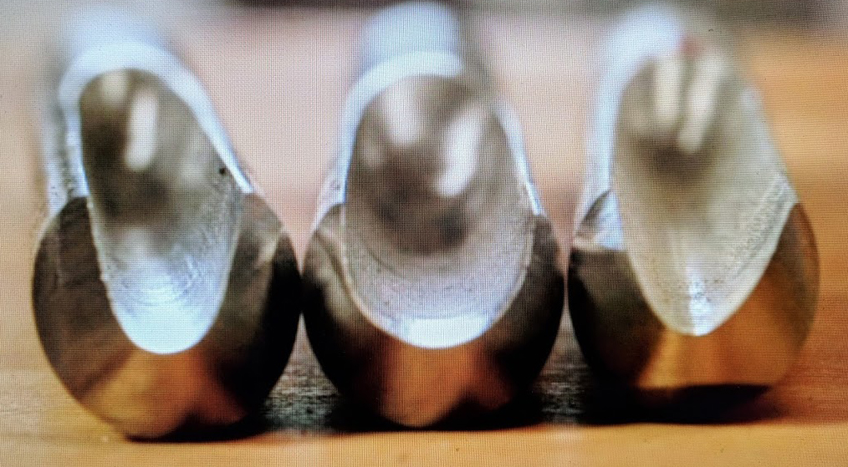
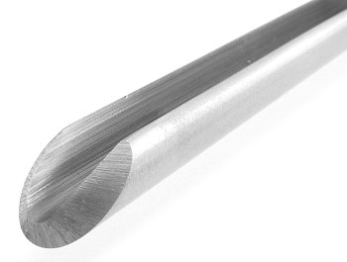
Sharpening Lathe Tools
“Bowl” Tools:
Bowl gouges
Scrapers

Slide 5
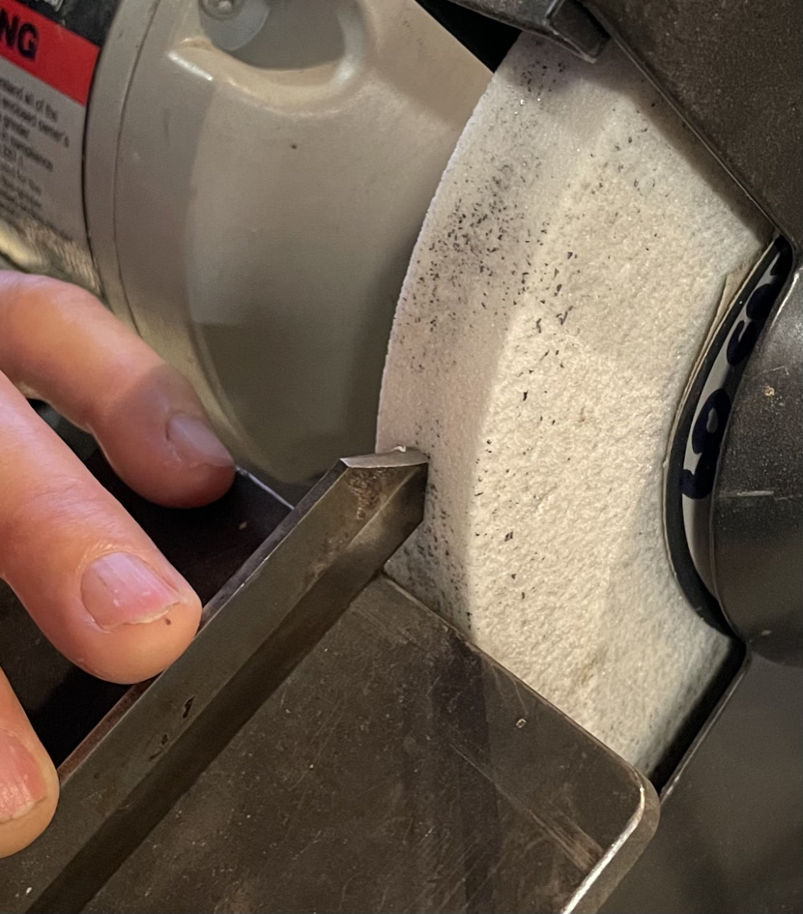
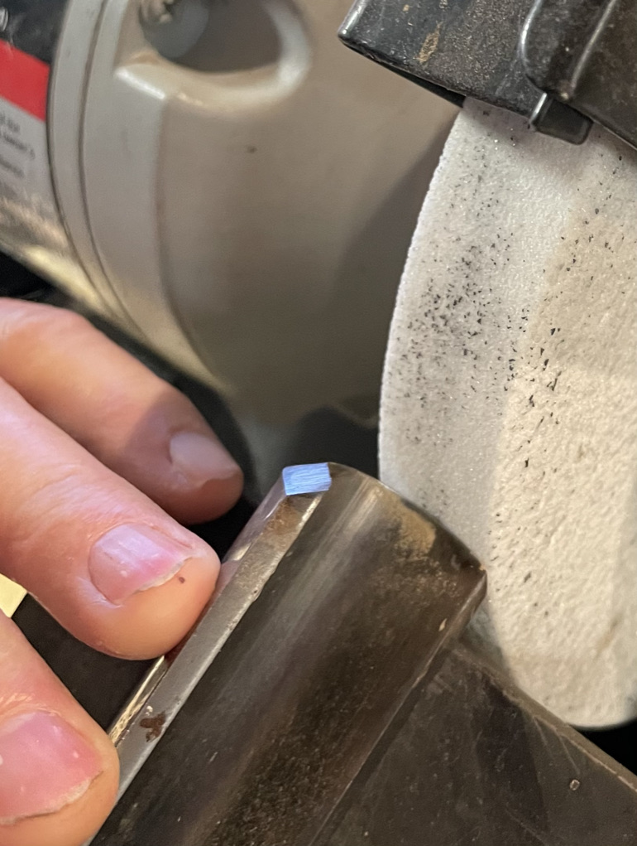
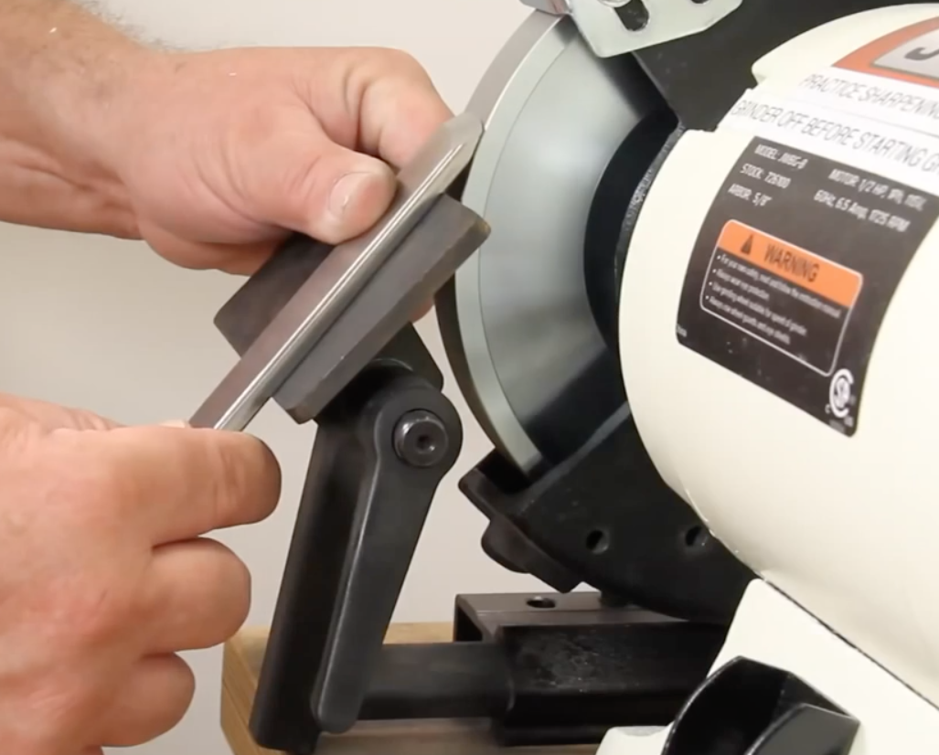
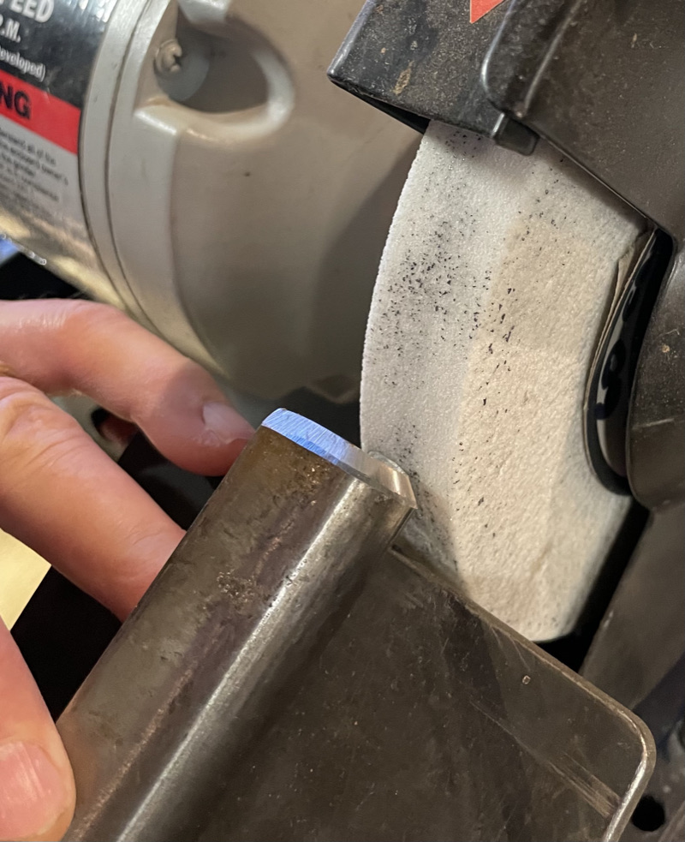
Sharpening Lathe Tools
Tools sharpened on a platform:
Parting tool
Skew
Spindle roughing gouge

Slide 6
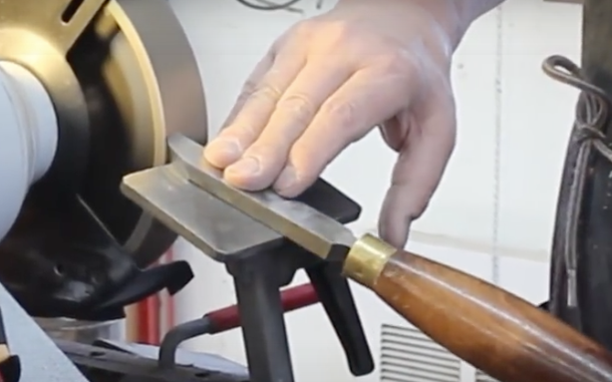
Sharpening Lathe Tools
Scrapers are sharpened using a tool platform set at an appropriate nose angle. The platform angle is adjustable.
The “burr” created by the grinding wheel is what does the the cutting.
After grinding, it’s best to create a very sharp cutting burr with a hand-held or bench-mounted knurling tool as shown at left.

Slide 7
Sharpening Lathe Tools
Because bowl and spindle gouges have a 3-dimensional cutting edge, we use a jig which holds the gouge firmly and allows rotating the cutting edge on the grinding wheel through the 3-dimensional curve.
Free-hand sharpening can be done, but takes practice.
This is the Wolverine “Vari-Grind Gouge Jig” used for sharpening bowl and spindle gouges.

Slide 8
Sharpening Lathe Tools
Bevel Angles on lathe tools:
There are many opinions, but...
Rules of thumb:
Spindle Roughing gouge 45°
Spindle gouge 35°
Bowl gouge 50°
Parting tool 45° (both sides)
Scraper 75 °
Skew 35° (inclusive)
Ultimately, you must decide what works best for you.

Slide 9
Sharpening Lathe Tools
What do I do with a new tool from the manufacturer?
Most of the time you’ll need to “re-shape” to your desired profile.
Always sharpen the cutting edge.
Sharpening is a very individual thing, and manufacturers do not intend that you use their tools “out of the box”.
What do I do with a used tool?
That will depend, but most of the time you’ll need to shape and sharpen to your desired configuration, just as if it was a new tool.
When buying used tools, stick with the good brand names (English and American Steels) from the known makers.

Slide 10
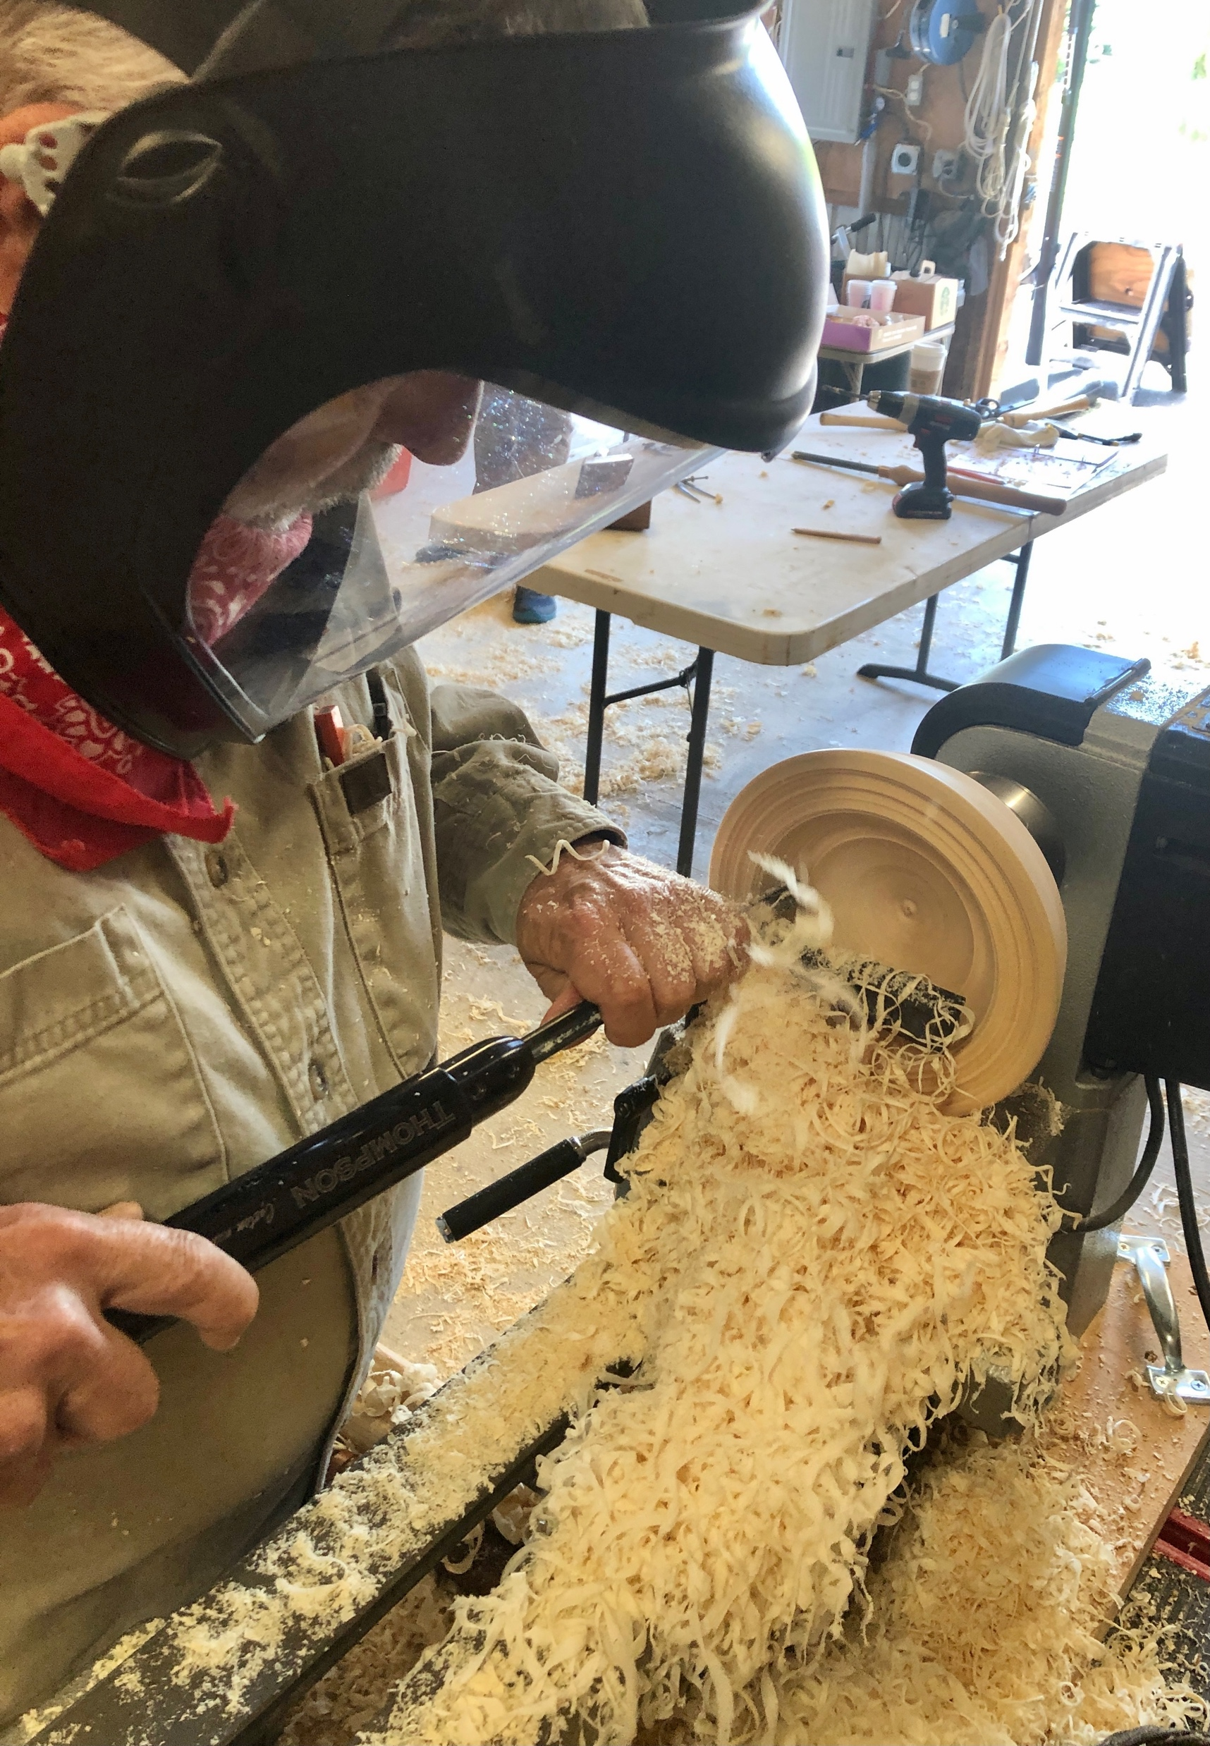
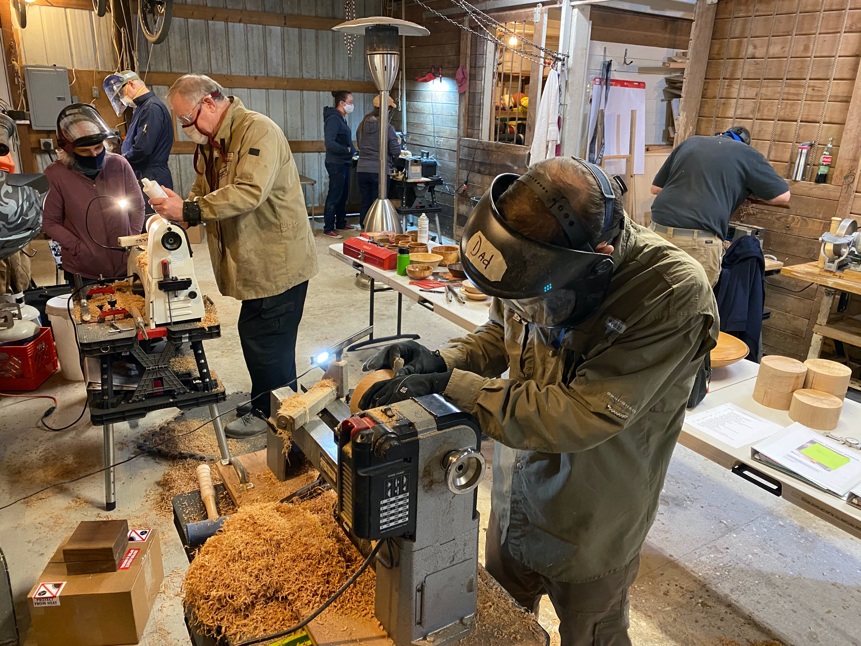
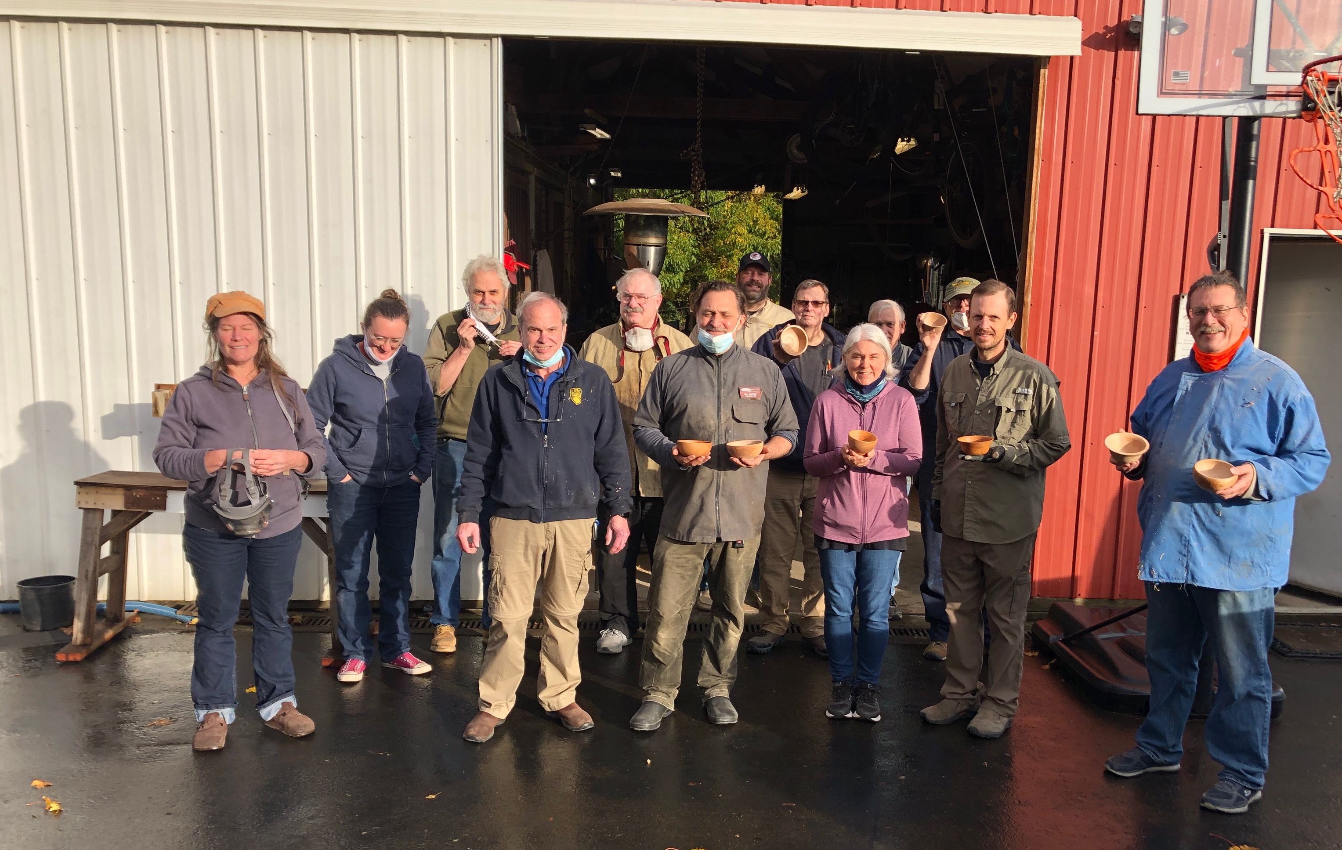
Sharpening Lathe Tools
Woodturning is great fun and therapy for the soul!
It’s relaxing and challenging at the same time. We learn and we give.
We create, we laugh, and we bond.
Come Join US!

