Slide 1
TOOLS
EVERY PRESENTATION SHOULD BEGIN WITH THE STATEMENT “THIS IS HOW I DO IT, NOT THE WAY TO DO IT.”
Everything you need to know to get started in Woodturning

Slide 2
WHY DO WOODTURNERS PAY SO MUCH ATTENTION TO TOOL BRANDS AND TOOL STEEL?
Turning tools –Why do we need high quality tool steel?
Cutting a 2-inch diameter piece rotating at 1000 rpm (not very fast) will cover one mile in 10 minutes. Tools must be able to hold an edge much longer than other woodworking tools
Choosing tools– The tools required for different turning tasks require different shapes
We can divide woodturning into two broad categories
The first is:
“Between Center Turning” aka “Spindle Turning”
*from Stevethewoodturner
Notes:
Turning tools must meet more demanding standard than other woodworking tools

Slide 3
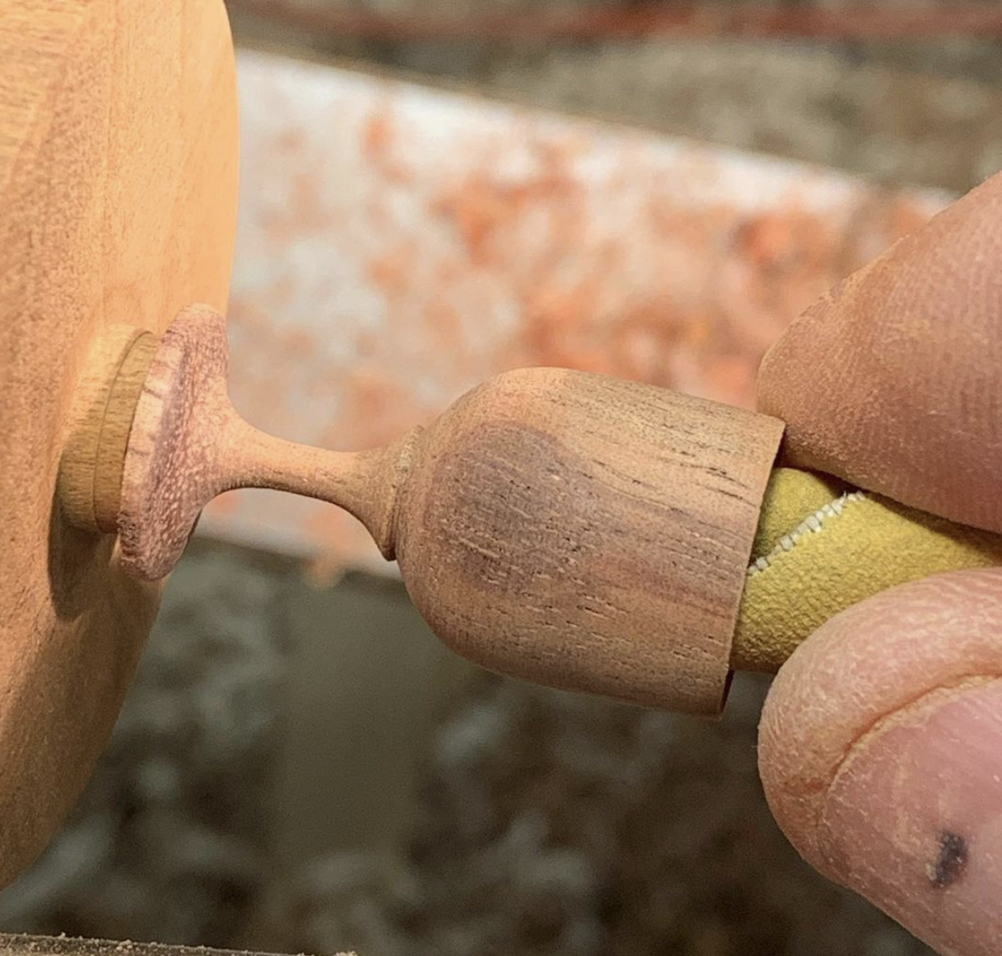
“Between Center Turning” aka “Spindle Turning”
Cuts are made with the fibers of the wood running parallel to the axis of rotation
This kind of turning produces spheres,
table legs, chair parts, handles, turned boxes, peppermills,
*from Stevethewoodturner

Slide 4
TOOLS FOR SPINDLE TURNING
STEPS FOR SPINDLE TURNING-
1: SQUARE TO ROUND– Roughing original shape to round
2: LAYING OUT DETAIL DIMENTIONS- Make a story stick
3: CUT DETAILS- Cut in beads, coves, rings, fillets, pommels

Slide 5
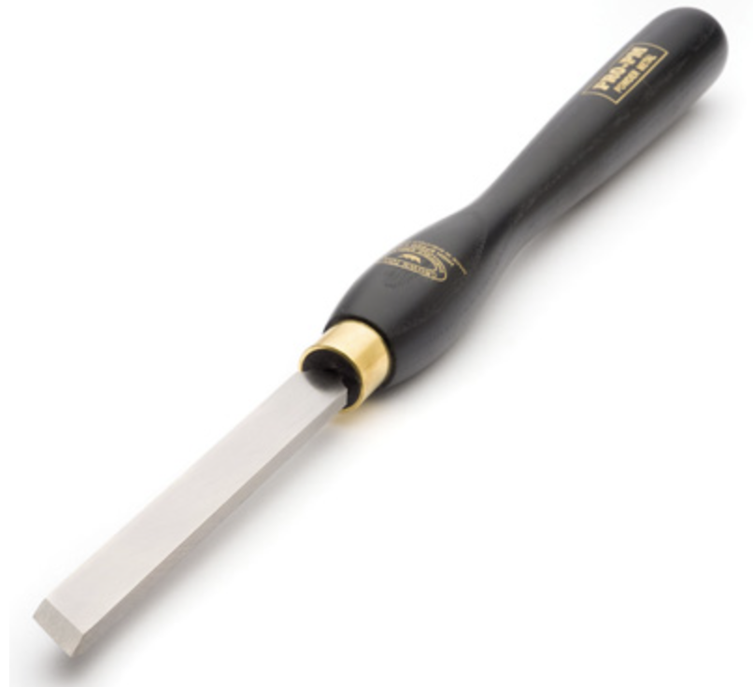
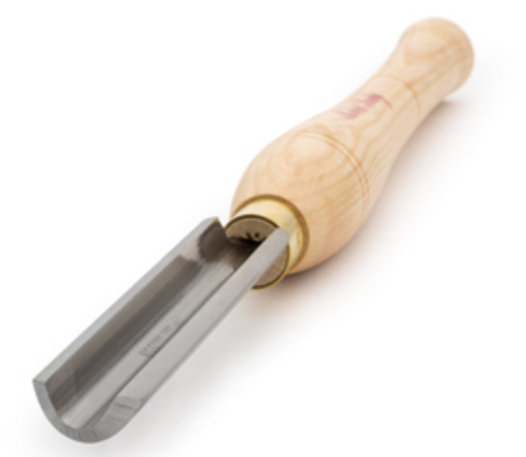
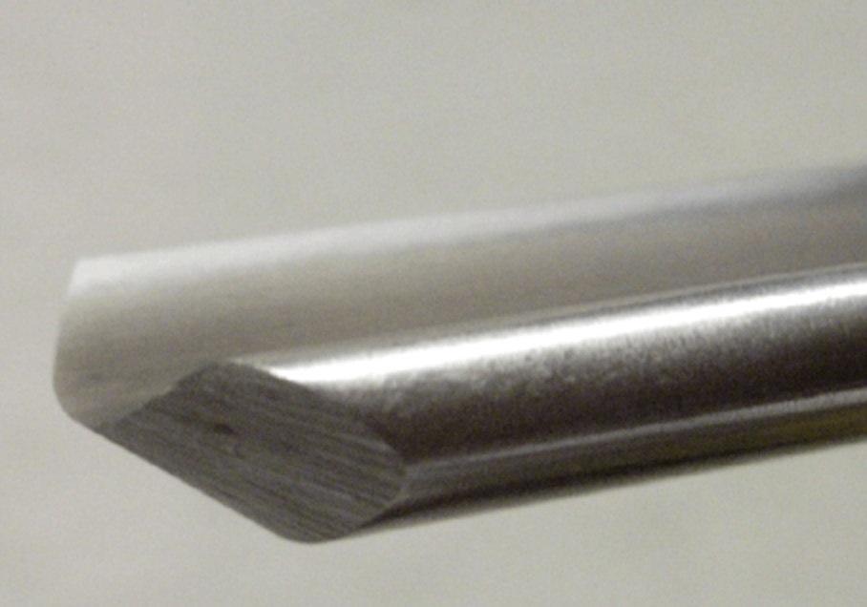
TOOLS FOR SPINDLE TURNING
STEPS FOR SPINDLE TURNING-
1: SQUARE TO ROUND– Roughing original shape to round
After mounting between centers, the wood is shaped with an “open throat” tool
Spindle Roughing Gouge Continental Gouge Skew Chisel

Slide 6
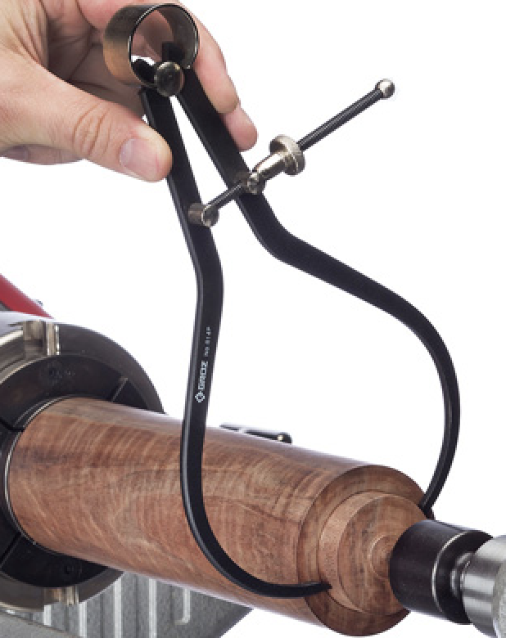
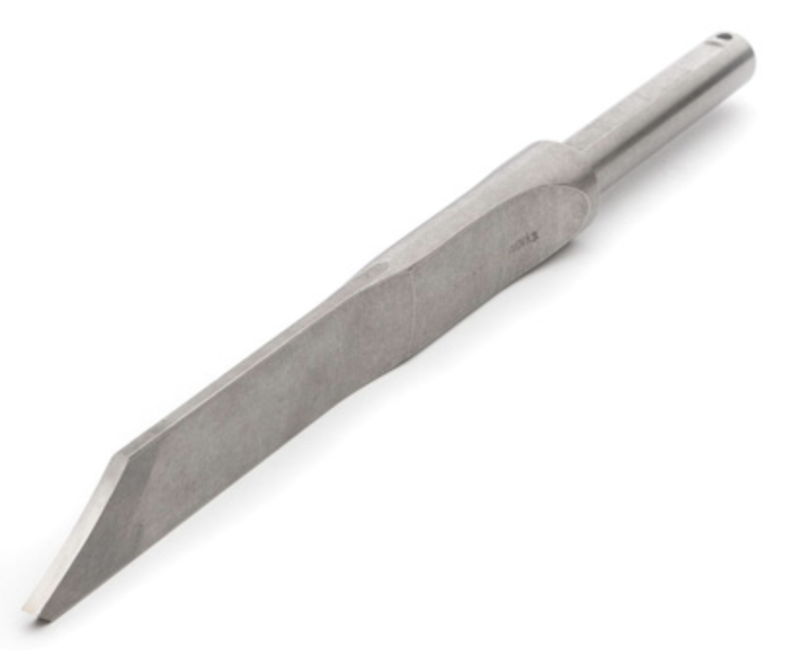
TOOLS FOR SPINDLE TURNING
STEPS FOR SPINDLE TURNING-
2: LAYING OUT DETAIL DIMENTIONS- Make a story stick
Transferring details to the surface to be turned is done by marking the width and depth of a feature
Parting Tool Skew Chisel Caliper

Slide 7
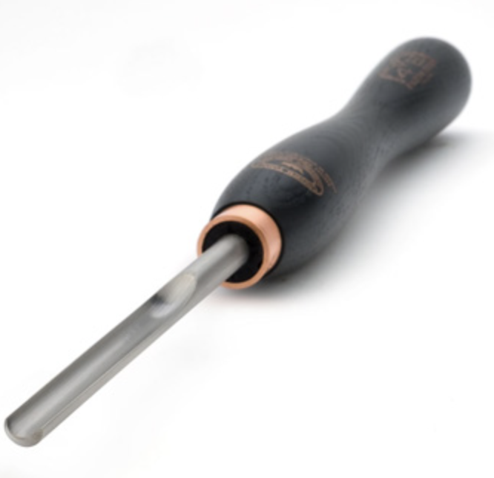
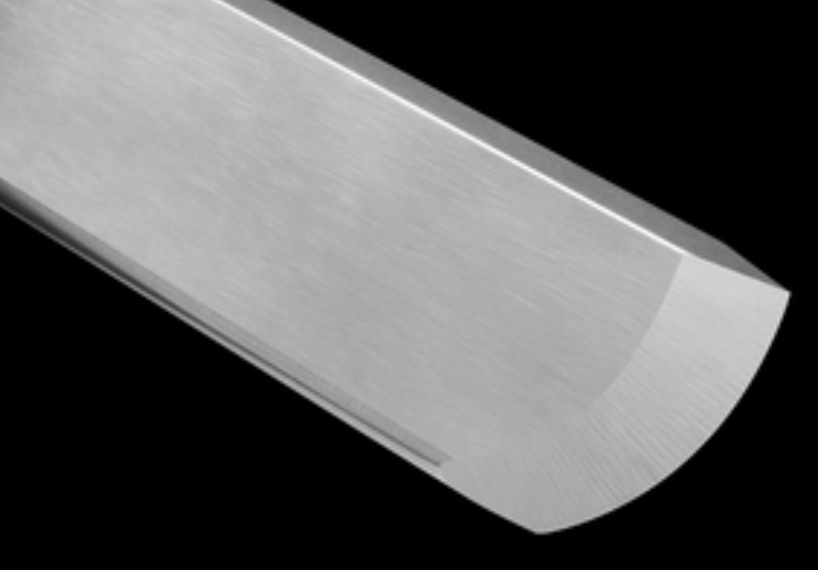
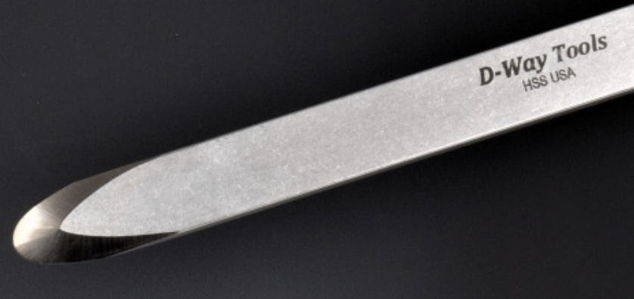
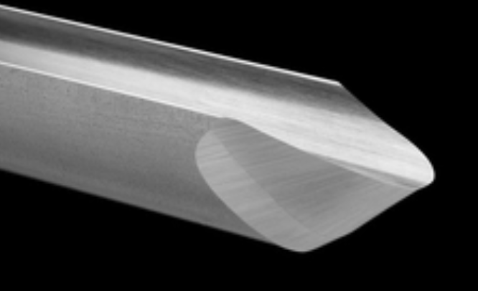
TOOLS FOR SPINDLE TURNING
STEPS FOR SPINDLE TURNING-
3: CUT DETAILS- Cut in beads, coves, rings, fillets, pommels
Spindle Gouge Skew Chisel Scraper

Slide 8
BOWL TURNING - FACE PLATE TURNING
In this turning style the fibers of the wood run across the axis of rotation
You can make bowls, plates, platters, vases, hollow form vessels
Notes:
Bowl tuning will use a chuck to hold the wood on the lathe or a FACE Plate.
The face plate is sort of a leftover from the old days of woodturning. If you looked under the green felt on the bottom off a project, you would see the screw holes left by the face plate.

Slide 9
TOOLS FOR WOODTURNING
The skew chisel, scraper, and parting tool are used in bowl turning
The spindle roughing gouge is used only for spindle turning
The bowl gouge is the major tool addition for bowl turning
Gouges vary by the depth and shape of the flute

Slide 10
FINDING TOOLS FOR TURNING
LOOK FOR USED TOOLS
Estate Sales, Club Auctions, Garage Sales
BUY CHEAP TOOLS?
If you keep them sharp, why not. (See Sharpening for best use of cheap tools)
“CHEAP TOOLS ARE NOT A BARGAIN, THEY’RE JUST CHEAP”
What tools do you need to get startedFor Spindle Turning:
Spindle Roughing Gouge, Parting Tool, 3/8-1/2” Spindle Gouge, 1/2” Bowl Gouge
William Whitford Meredith-1960

Slide 11
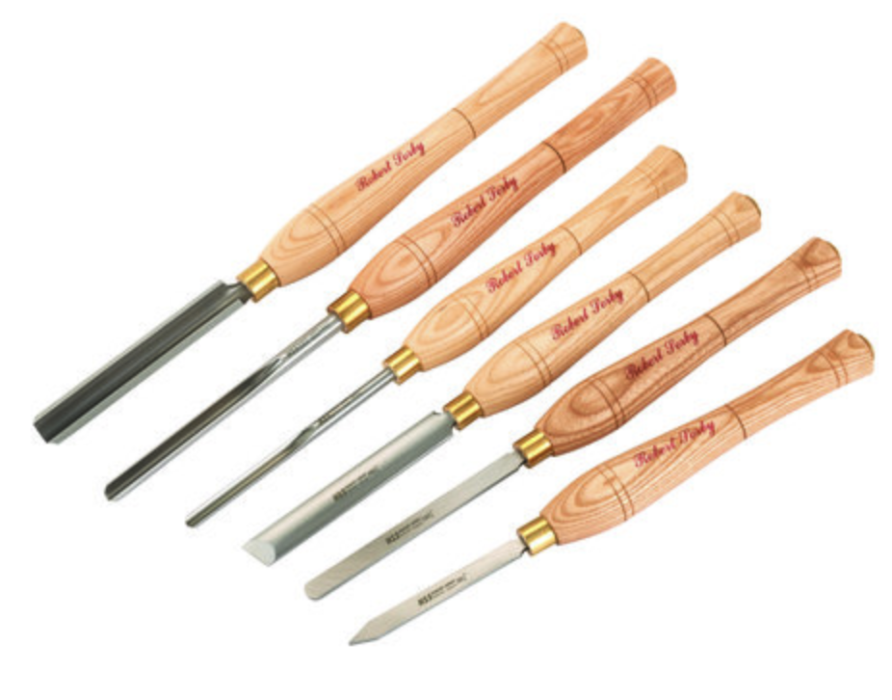
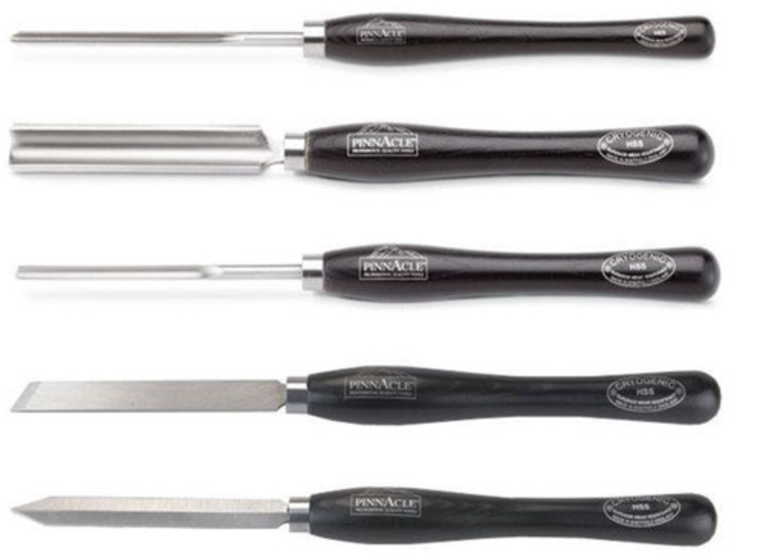
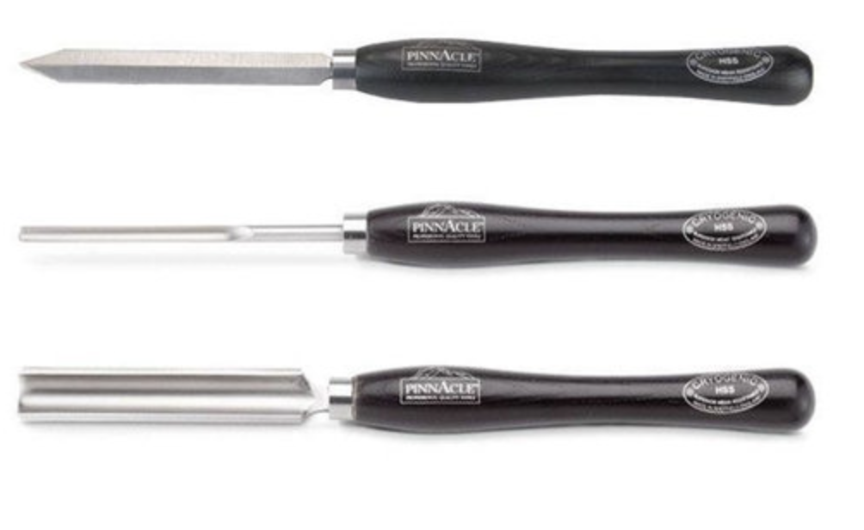
TOOLS FOR WOODTURNING
How do you begin acquiring tools?
TOOL SETS?
Maybe-good price if the set has what you want
Chinese made/English M2cryosteel
SORBY 6 piece $350 Pinnacle 5 Piece set
$350
English M2 steel Pinnacle 3 Piece
Spindle Set $190

Slide 12
TOOLS FOR WOODTURNING
How do you begin acquiring tools?
Buy only the tool that your need? Requires very good guessing about there your interest will go.
First best bet: Get a set at a sale.
Roughing gouge, spindle gouge, parting tool and add tools as required.

Slide 13
TOOLS FOR WOODTURNING
In the beginning, you do not need every tool

Slide 14
TOOLS FOR WOODTURNING
…..that will
come later

Slide 15
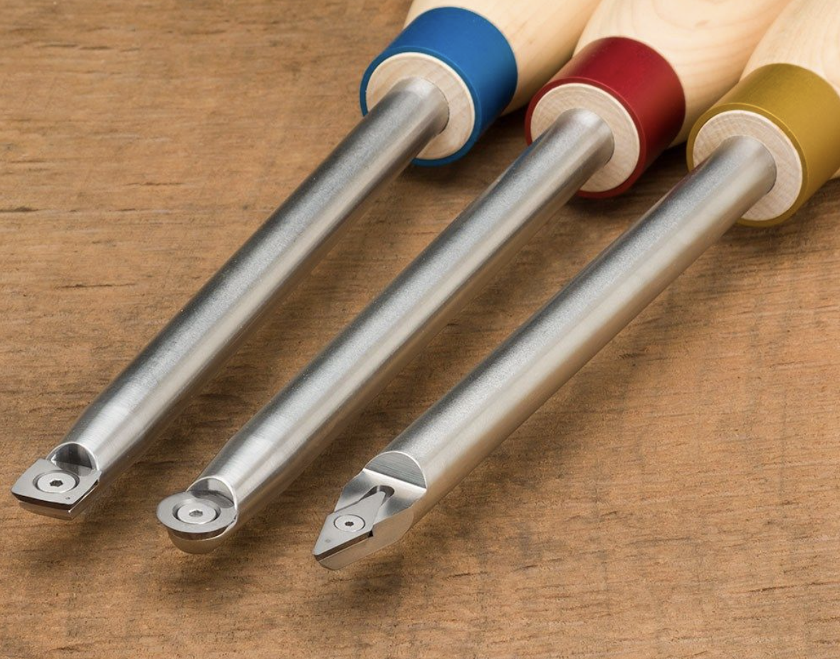
TOOLS FOR WOODTURNING
A new type of turning tool has come on the market in the last few years that uses a carbide scraper to move wood
Notes:
Carbide specialty tools can be very useful-hollowing tools

Slide 16
TOOLS FOR WOODTURNING
The advantage is that you don’t sharpen them like standard steel tool. Carbide is a very hard edge and holds up much longer than a steel tool.

Slide 17
TOOLS FOR WOODTURNING
The disadvantage is that it’s a scraper and does not leave a very good surface. More sanding is required.

Slide 18
TOOLS FOR WOODTURNING
“Every tool is really good at something”
Carbide tools are good for tasks where a high-quality surface is not required such as Rough Turning
Carbide roughing tools remove wood very efficiently

Slide 19
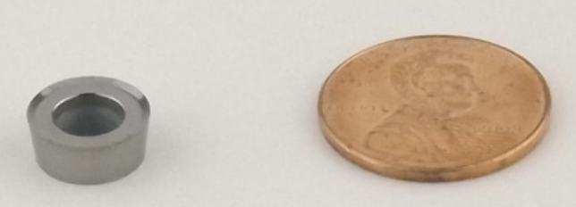
TOOLS FOR WOODTURNING
Another type of carbide tool is the carbide cutter ring tool-Hunter tools
Cuts instead of scraping, they cut with a ring cutting edge
Carbide rings can be found on almost any type of turning tool
No sharpening needed, simply rotate to a sharp section of the ring then replace the ring which costs $10 to $20 depending on size

Slide 20
TOOLS FOR WOODTURNING
Lots of choices for the new turner
Start small
Add tools as your expertise and interests grow

